Slide 1
Moving averages (MAs)
You can create a moving average for any timeframe you wish. A 20-day MA, for instance, will show you a market’s average price over the past 20 days. A five-day MA, on the other hand, averages out the last five days of price action.
The two most popular, though, are simple moving averages (SMAs) and exponential moving averages (EMAs).
The most popular moving averages cover 5, 10, 20, 50, 100 and 200 days.

Slide 2
Trading with MAs
In general, a market may be considered bullish when it is trading above its moving average, and bearish if it is below. However, there are a few other common signals that traders might look out for:
A buy signal if the moving average is rising and pointing up
A buy signal if the market closes above the moving average
A sell signal if the MA is falling and pointing down
A sell signal if the market closes below its MA

Slide 3
Moving average crossovers
One popular way to MAs is to watch for crossovers. This involves using two MAs at once:
One is slower, meaning it has a long-term timeframe (say, 50 days or more)
One is faster, meaning it has a short-term timeframe (15 days or less)
A crossover occurs when the faster MA crosses the long-term one. If it crosses from below to above (crosses up), then it is taken as a sign that the market is entering an uptrend. If it crosses from above to below (down), then a bear run may be on the cards.
The levels at which the lines cross may also become a new support or resistance area.
One drawback to using MAs is that they can be a heavily lagging indicator, as they require lots of past price data to function. Because of this, they may give false signals, when the market move you predicted using the indicator has petered out by the time you come to trade it.

Slide 4
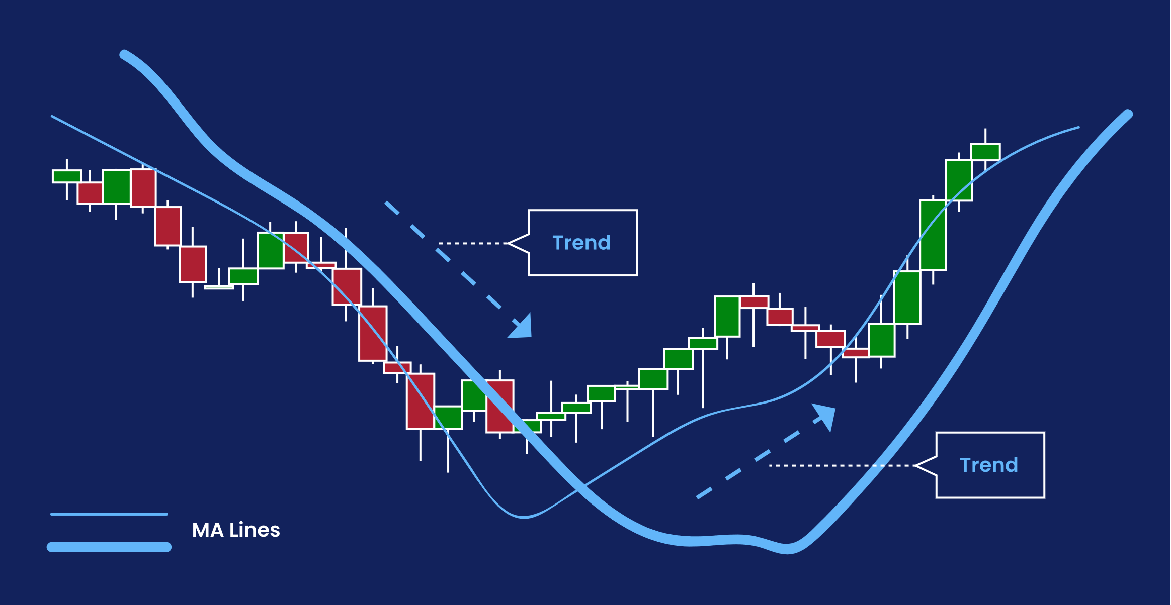

Slide 5
MACD
As well as being used on their own, moving averages form the basis for several other indicators – including moving average convergence divergence, or MACD.
When you select MACD on a chart, it will appear in its own box, usually at the bottom. In the box, you’ll see three components:
The MACD line, which is calculated by subtracting the market’s 26-period EMA from its 12-period EMA
The signal line, which is a nine-day EMA of the MACD line
A histogram, which measures the difference between the MACD line and the signal line
If the market’s 12-period EMA is above its 26-period EMA, then the MACD line will be positive. If its 26-period is above the 12-period EMA, then it will be negative.

Slide 6
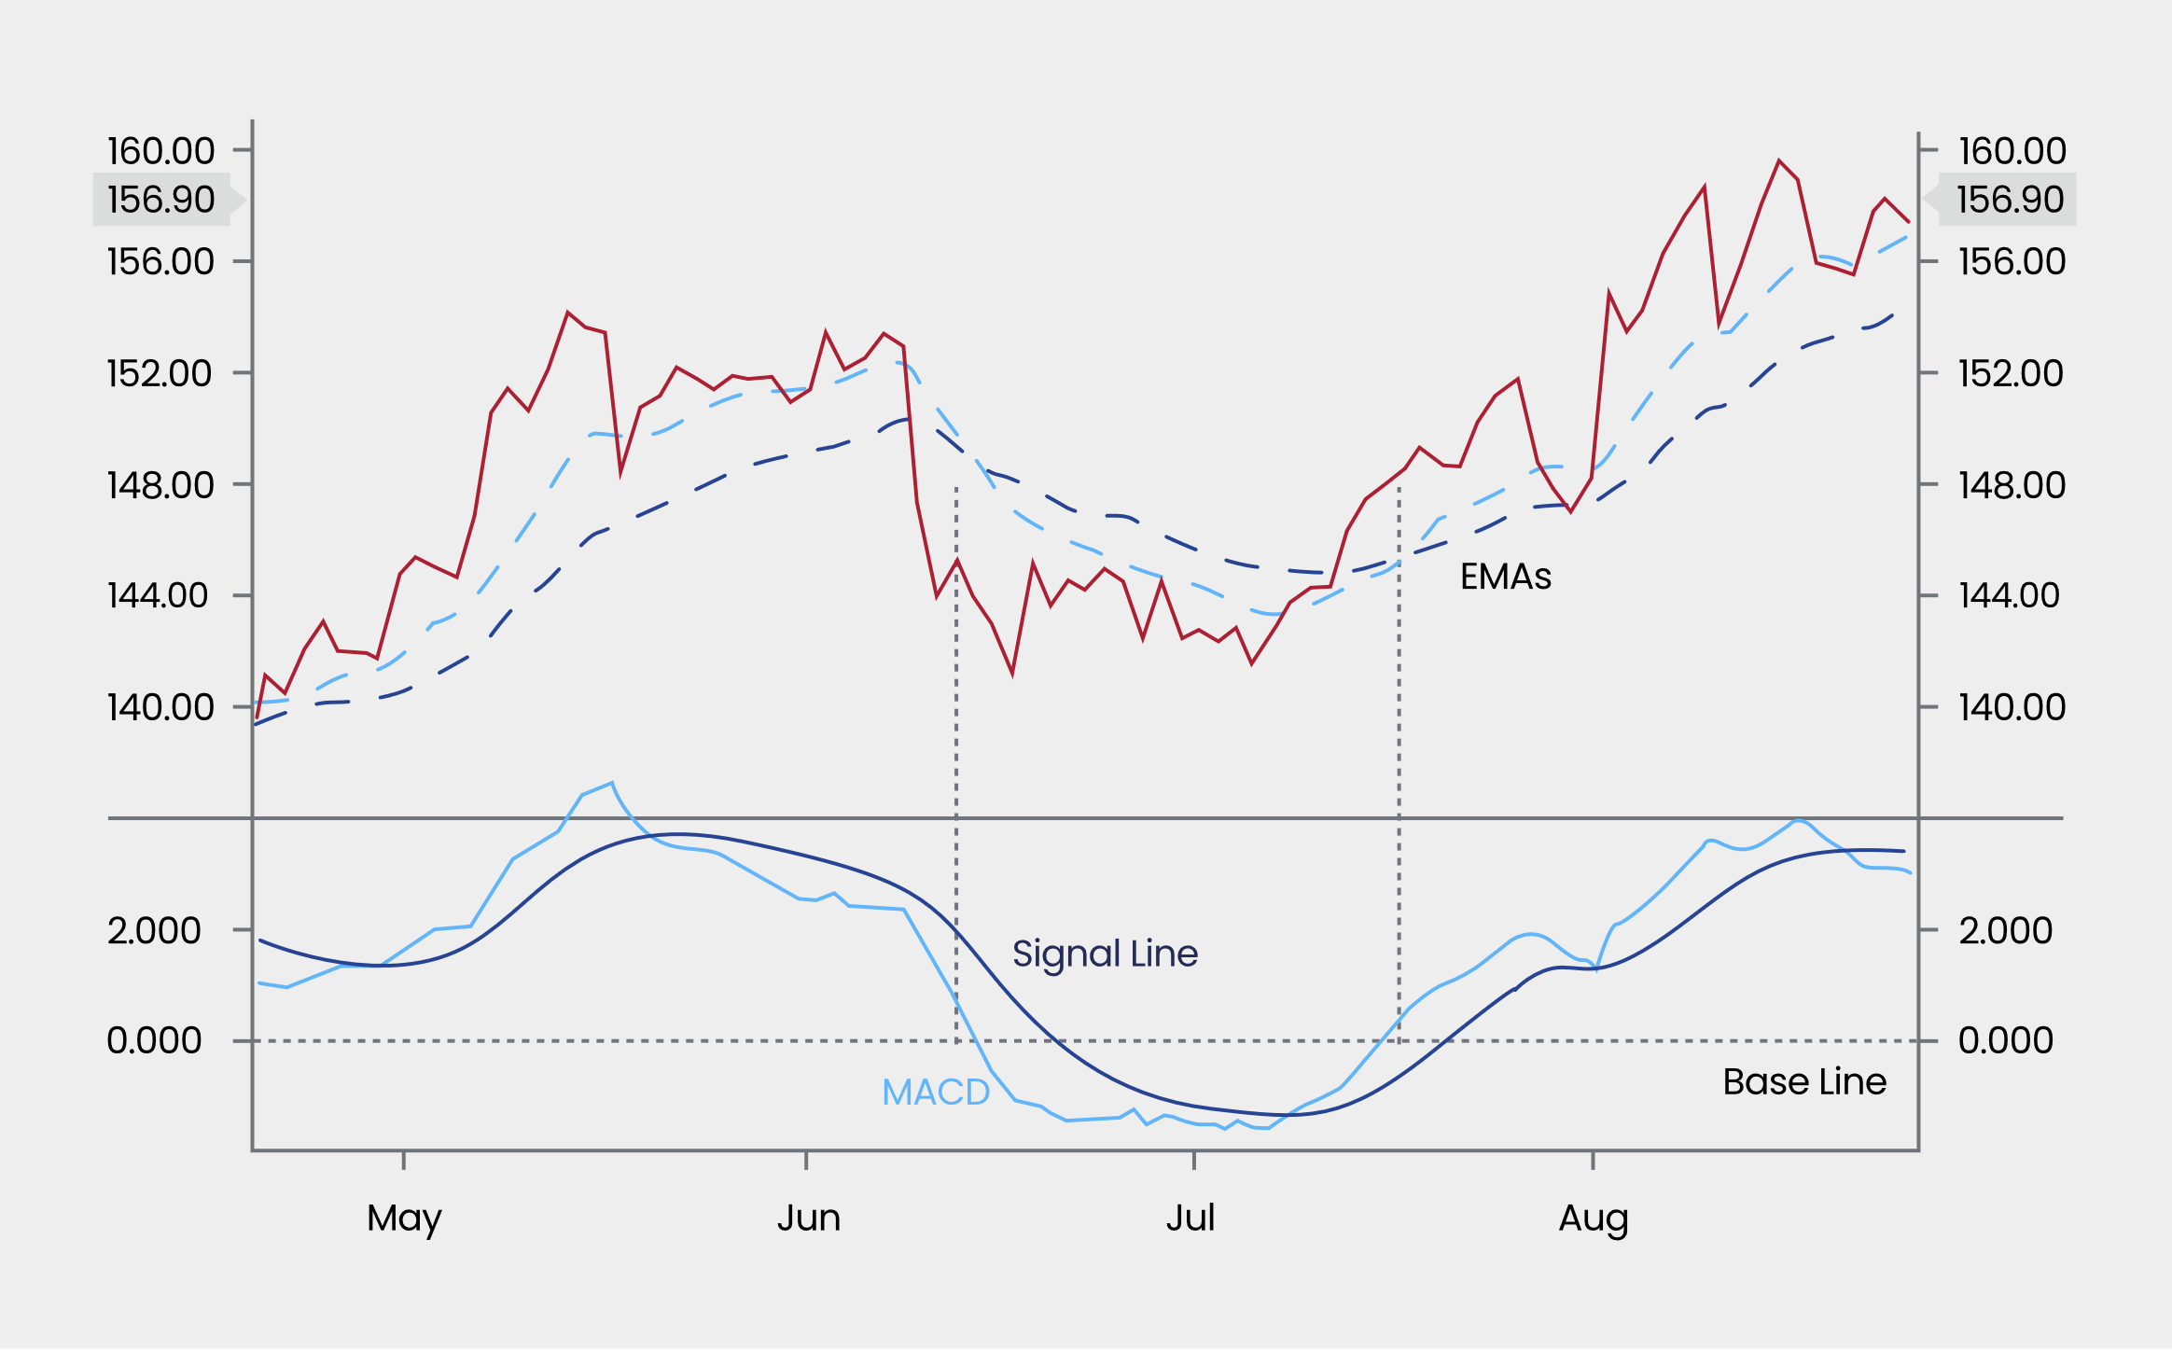

Slide 7
Crossovers | Zero-line crosses | Divergences
Just like with standard MAs, a crossover between the MACD line and signal line can indicate that a trend is forming. If the MACD line crosses above the signal line, it is seen as a bullish signal. If the opposite happens, it is bearish. | Alternatively, you can watch for when the MACD line crosses the zero line. If the MACD line crosses below the zero line then it may signal a bear run. If it crosses above, it may signal a bull market. | If a market is hitting new highs but the MACD indicator is not following suit, then a divergence may be forming. This means that the market and indicator are out of sync, and a reversal may be at hand.

Slide 8
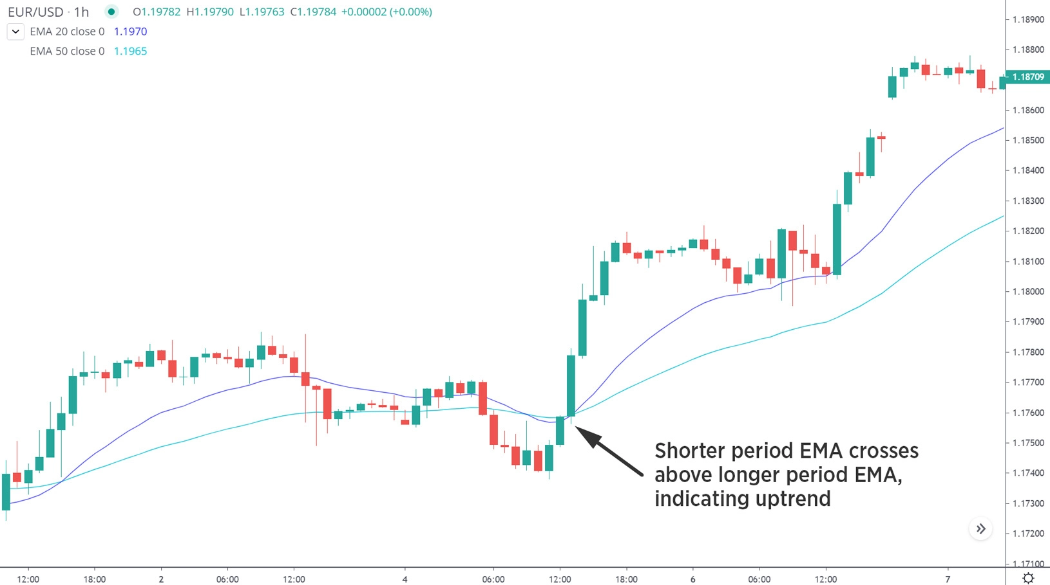
Using MAs in a day trading strategy: example
Here, 20 and 50-period EMAs are used on a one-hour chart to ascertain a wider trend, with the intention to open and close positions on a 15-minute chart.

Slide 9
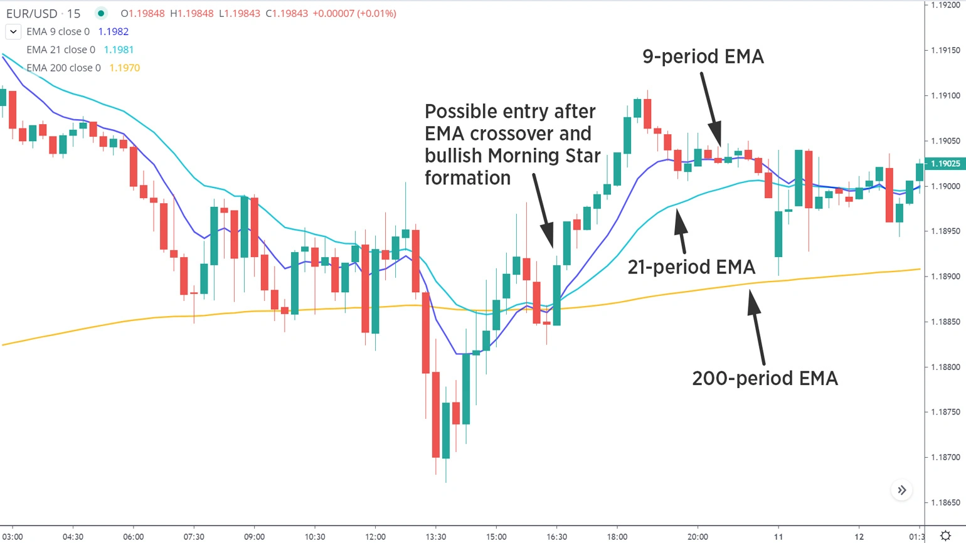
Now let’s look at a simple moving average crossover strategy on the chart below. A trader may choose longs when the 9-period EMA crosses above the 21-period EMA, and when price is above the 200-period EMA. Conversely, shorts may be taken when the 9-period EMA crosses below the 21-period EMA, and when price drops below the 200-period EMA.

Slide 10
Here, a long green candle completes above the 200-period EMA and coincides with a bullish EMA crossover, making it a reasonable long-entry choice.
In this case, a tight stop may be placed just beneath the crossover, while a more aggressive choice of stop placement would be further down at the recent swing low. However, a stop that is too tight may exit a trade prematurely, while losses may mount quickly if a stop is too far away. With time, traders can find the balance that works for their style.

Slide 11
More Indicators

Slide 12
Bollinger Bands
Bollinger bands take the form of three lines:
The middle line is a moving average of the given market
An upper band, which is two standard deviations above the MA
A lower band, which is two standard deviations below the MA
A standard deviation is a measure of how close prices are to the average. So, when the two bands are far apart, prices are far from the average and the market is in a period of high volatility. When they are close, it is relatively calm.
Trading with Bollinger bands
There are a few different ways to read Bollinger bands. One of the most common is to look at how close your market’s live price is to either band.

Slide 13
Upper band | Lower band | Middle line
If the price is close to the upper band, then it is considered high relative to the average. If it moves beyond the upper band, it is overbought. This could be a good time to short the market. | If the price is close to the lower band, then it is considered low relative to its average. If it moves beyond the lower band, it may be oversold, which could mean it’s a good time to buy. | If the market is close to the middle line, then its price is fairly close to its average. It isn’t overbought or oversold, so no signal is generated.

Slide 14
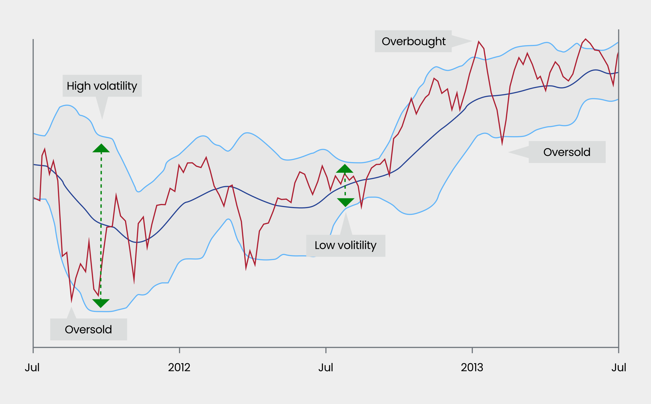

Slide 15
Stochastic oscillator
The stochastic oscillator is formed of two lines on a sub chart:
The %K line compares the market’s close for the day to its trading range over the past 14 days
The %D line is the signal line. In this case, a five-day SMA of the %K line

Slide 16
